Slide 1
Project on web development Project name: Online School system
Course no: CSE3100
Course title: Web development laboratory

Slide 2

Submitted to
Prottoy saha
Lecturer
Mahmudul hasan
Lecturer
Department of Computer science and engineering
Khulna University of Engineering and Technology
Khulna -9203,Bangladesh

Slide 3
Presented by:
Name: Delowar sikder
Roll :1607094
Department of Computer science and engineering
Khulna University of Engineering and Technology
Khulna -9203,Bangladesh

Slide 4
Development element
Asp.net
Html
Css
Java script
Uses element
Session
Cookie
Database

Slide 5
Project Feature
Registration
Login
Homepage
User Profile
Teacher profile
Feed back
Logout

Slide 6
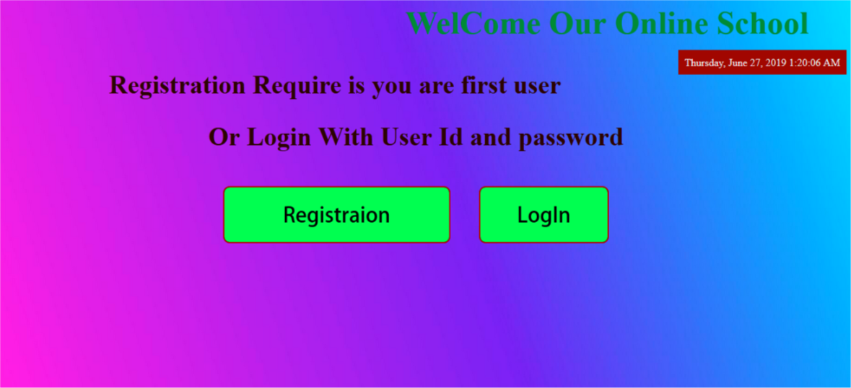
Page over view

Slide 7
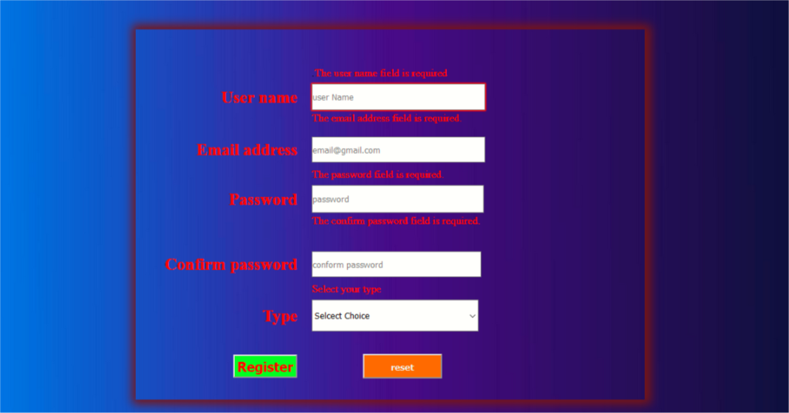
Page over view

Slide 8
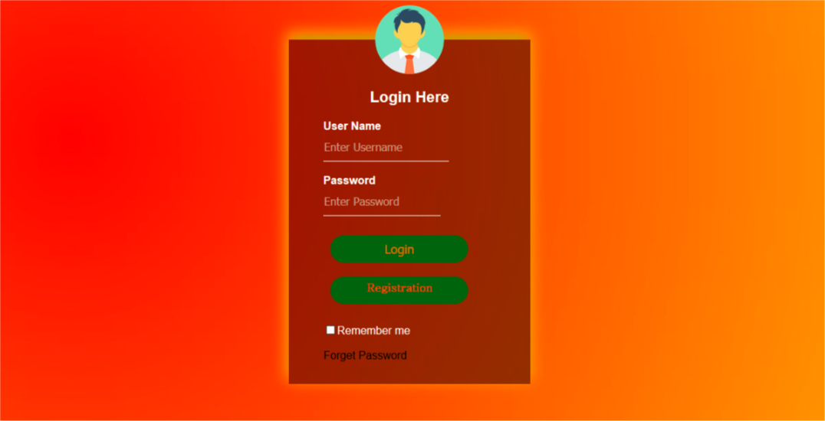
Page over view

Slide 9
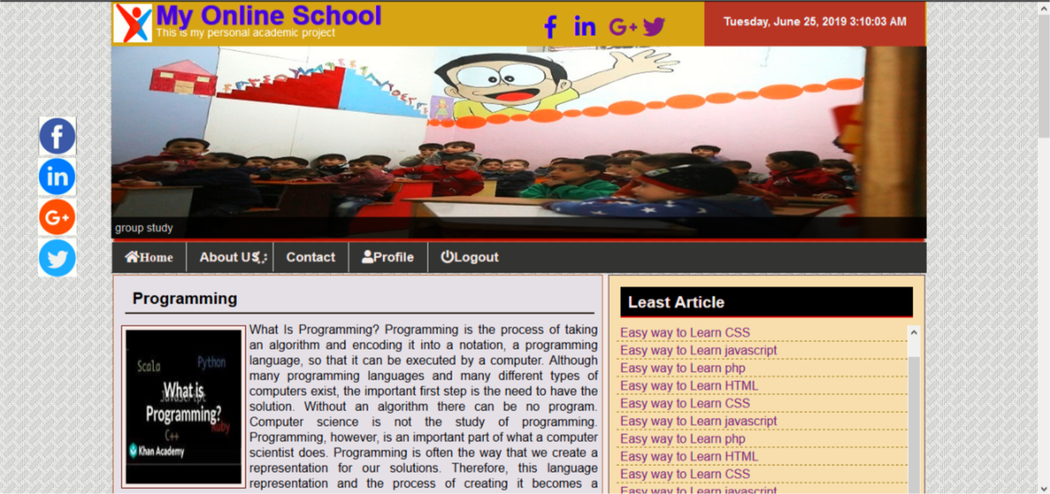
Page overview

Slide 10
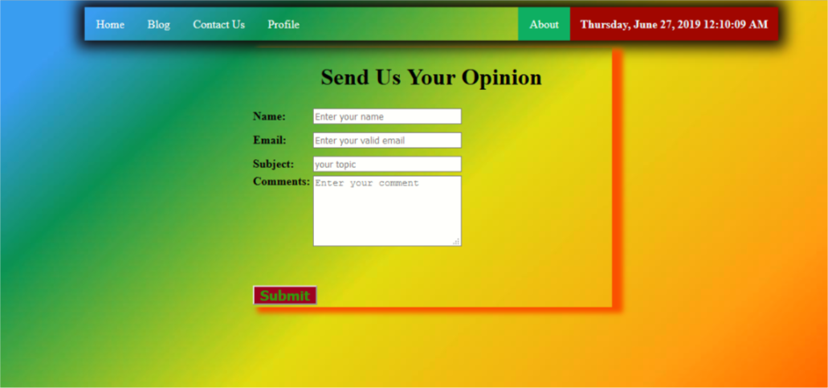
Page over view

Slide 11
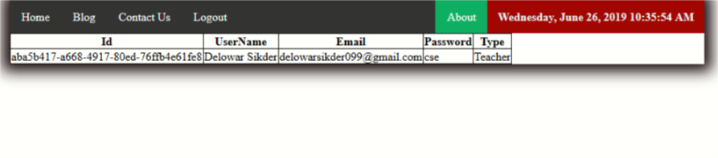
Page over view

Slide 12
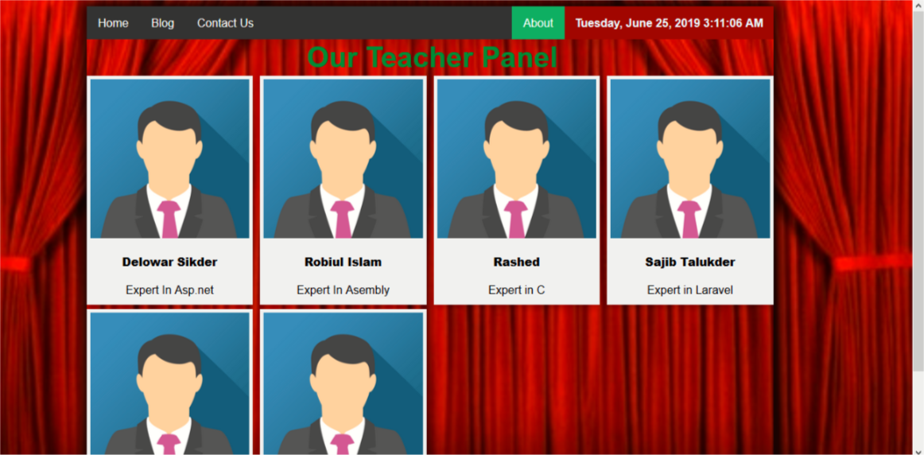
Page over view

Slide 13
Find GitHub my project
My project link : https://github.com/delowarsikder/webdevelopmentproject

Slide 14
Thank you

